Slide 1
Decision Support Systems
Maged Ibrahim El-Sayed Eid

Slide 2

Decision: the action or process of deciding something or of resolving a question. OR cognitive process resulting in the selection of a belief or a course of action among several alternatives.

Slide 3

Types of Decision: Programmed: concerned with the problems that occurred regularly type matters, These decisions are taken generally by lower level managers. Non-programmed: relate to difficult situations for which there is no easy solution. These matters are very important for the organization. For example: opening of a new branch of the organization.

Slide 4


Major: EX: A decision related to the purchase of a new server (something not on a daily basis) Big matter. Minor: EX: A decision related to the purchase of a pack of papers or box of pens (daily basis gadgets not something that big) small matter.

Slide 5

Routine: decisions are of repetitive nature, do not require much analysis and evaluation, are in the context of day-to-day operations of the enterprise and can be made quickly at middle manage­ment level. Strategic: decisions relate to policy matter, are taken at higher levels of management after careful analysis and evaluation of various alternatives, involve large expenditure of funds and a slight mistake in decision making is injurious to the enterprise.

Slide 6
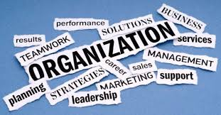

Organizational and Personal Decisions: A manager makes organizational decisions in the capacity of a company officer. Such decisions reflect the basic policy of the company. They can be delegated to others. Personal decisions relate the manager as an individual and not as a member of an organization. Such decisions cannot be delegated.

Slide 7

Individual and Group Decisions: Individual decisions are taken by a single individual in context of routine decisions where guide­lines are already provided. Group decisions are taken by a committee constituted for this specific purpose. Such decisions are very important for the organization.

Slide 8
Policy and Operative Decisions: Policy decisions are very important, they are taken by top management, they have a long-term impact and mostly relate to basic policies. Operative decisions relate to day-to-day operations of the enterprise and are taken at lower or middle management level. Whether to give bonus to employees is a policy decision but calculating bonus for each employee is an operative decision.

Slide 9
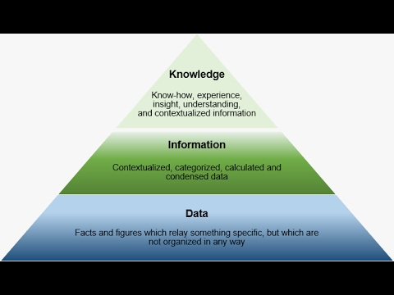

Slide 10
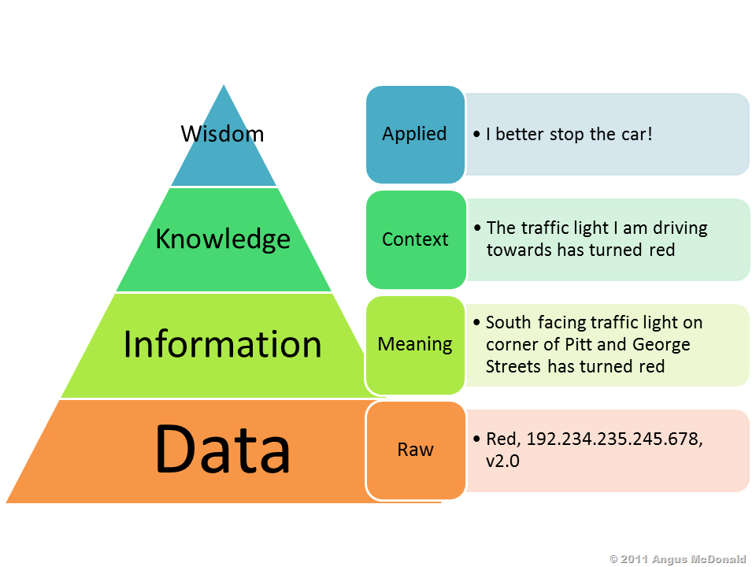

Slide 11
Data: Information in raw or unorganized form (such as alphabets, numbers, or symbols) Information: facts provided or learned about something or someone OR what is conveyed or represented by a particular arrangement or sequence of things. Knowledge: the theoretical or practical understanding of a subject to make a benefit from the information you get.

Slide 12
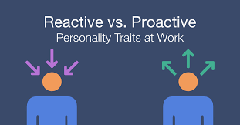

Reactive: showing a response to a stimulus. Proactive: ready before something happens. The opposite is being reactive, or waiting for things to unfold before responding.

Slide 13
Anticipative: the action of anticipating something, expectation or prediction. Adaptive: to describe people who are flexible they don't lose their cool when plans change quickly and they are always willing to learn new ways to do things. Being adaptive helps you sail along in today's ever-changing world.

Slide 14

Mintzberg: published his Ten Management Roles in his book, "Mintzberg on Management: Inside our Strange World of Organizations," in 1990. The 10 roles are then divided up into three categories, as follows:

Slide 15
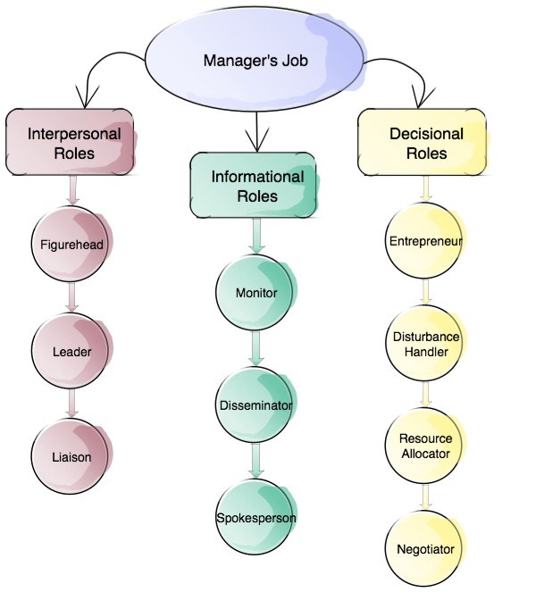

Slide 16

Interpersonal Category: Figurehead: As a manager, you have social, ceremonial and legal responsibilities. You're expected to be a source of inspiration. People look up to you as a person with authority, and as a figurehead. Leader: This is where you provide leadership for your team, your department or perhaps your entire organization; and it's where you manage the performance and responsibilities of everyone in the group. Liaison: Managers must communicate with internal and external contacts. You need to be able to network effectively on behalf of your organization.

Slide 17
Informational Category: Monitor: In this role, you regularly seek out information related to your organization and industry, looking for relevant changes in the environment. You also monitor your team, in terms of both their productivity, and their well-being. Disseminator: This is where you communicate potentially useful information to your colleagues and your team. Spokesperson: Managers represent and speak for their organization. In this role, you're responsible for transmitting information about your organization and its goals to the people outside it.

Slide 18
Decisional Category: Entrepreneur: As a manager, you create and control change within the organization. This means solving problems, generating new ideas, and implementing them. Disturbance Handler: When an organization or team hits an unexpected roadblock, it's the manager who must take charge. You also need to help mediate disputes within it. Resource Allocator: You'll also need to determine where organizational resources are best applied. This involves allocating funding, as well as assigning staff and other organizational resources. Negotiator: You may be needed to take part in, and direct, important negotiations within your team, department, or organization.

Slide 19

Model: a usually miniature representation of something, also a pattern of something to be made (something good to be copied). OR steps to reach a goal.

Slide 20
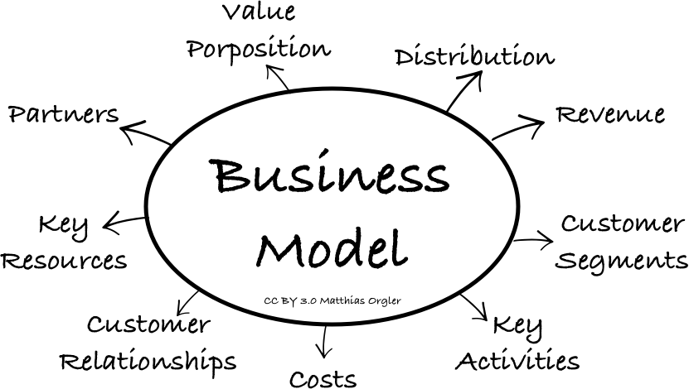

Slide 21
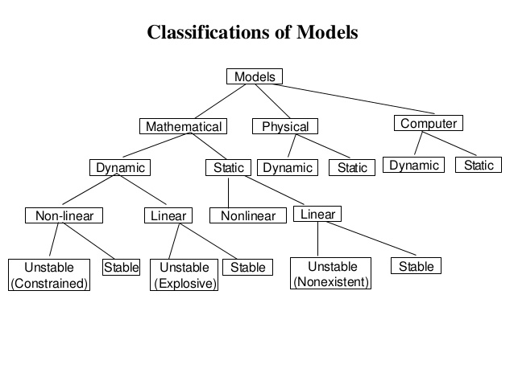
Models Types:

Slide 22

Business intelligence (BI): is a technology-driven process for analyzing data and presenting actionable information which helps executives, managers and other corporate end users make informed business decisions. Types: .Spreadsheets .Reporting and querying software: applications that extract, sort, .summarize, and present selected data .Online analytical processing (OLAP) .Digital dashboards .Data mining .Business activity monitoring .Data warehouse

Slide 23
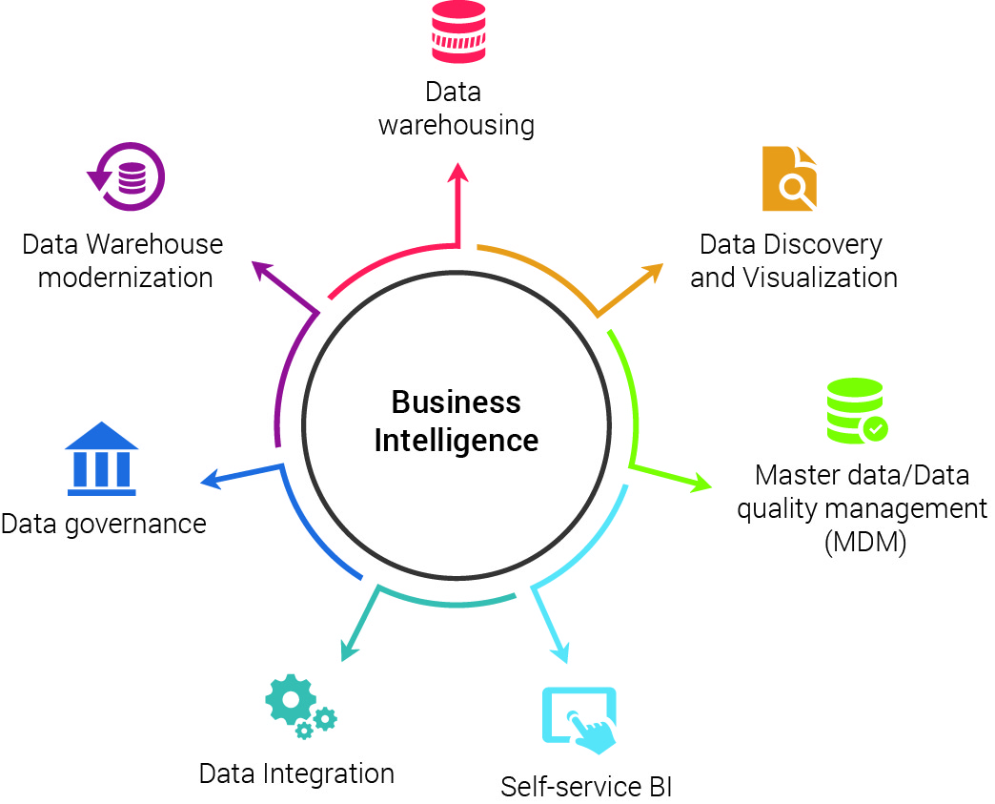

Slide 24

KNIME: The Konstanz Information Miner, is a free and open-source data analytics, reporting and integration platform. KNIME integrates various components for machine learning and data mining through its modular data pipelining concept.

Slide 25
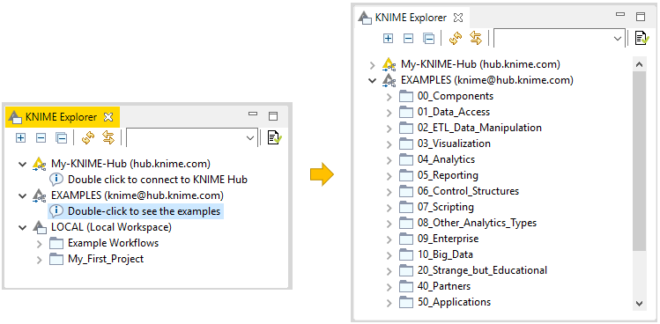

Slide 26
THANKS

